Slide 1
Flying Ad-Hoc Networks
Presented By:
Anna Dieckvoss (1127324)
Harika Kudarvalli (0887033)
Guided By:
Dr. Dariush Ebrahimi

Slide 2

Overview
FANET Fundamentals
Social and Technical Implications
Communication Architectures
Routing Protocols
Implementation
Results
Conclusion

Slide 3
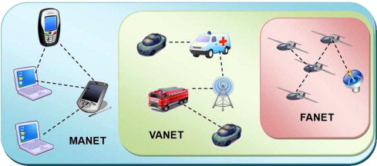
Introduction
Source: https://www.sciencedirect.com/science/article/pii/S1570870512002193#f0015
Notes:
Flying ad hoc networks are basically ad hoc networks between Unamnned air vehicle. FANET can be viewed as a special form of MANET and VANET
Special about FANET: differences between FANET and existing ad hoc networks
· Mobility degree of FANET nodes is much higher
· Topology changes more frequently than the network topology of a typical MANET or VANET
· Distances between FANET nodes are much longer
· Multi UAV systems may include different types of sensors with different data delivery strategies
Challenges:
· due to the high mobility of nodes it is a hard task to maintain a communication linkbetween the UAVs.
· More dynamic topology than MANET
· Routing protocols designed for MANET fail in tracking network topology changes
·

Slide 4
Literature Survey
Ozgur Koray Sahingoz , Networking Models in Flying Ad-Hoc Network (FANETs): Concepts and Challenges, Springer Science+Business Media Dordrecht, October 2013.
Wajiya Zafar and Bilal Muhammad Khan , Technological and Social Implications - Flying Ad-Hoc Networks,NO. 16 IEEE Technology and Society Magazine, June 2016.
Do-Yup Kim and Jang-Won Lee, Topology Construction for Flying Ad Hoc Networks (FANETs),NO. 16 2017 IEEE.
Huda Yousef, Salimur Choudhury, Ebrahim Bedeer , and Salama S. Ikki, Near-Optimal Resource Allocation Algorithms for 5G+ Cellular Networks,VOL. 68, NO. 7 IEEE TRANSACTIONS ON VEHICULAR TECHNOLOGY, JULY 2019.
Muhammad Asghar Khan and Alamgir Safi and Ijaz Mansoor Qureshi and Inam Ullah Khan , Flying Ad-Hoc Networks (FANETs): A Review of Communication architectures, and Routing protocols, IEEE Technology and Society Magazine, 2017.
Notes:
This are the paper we based our work on.
1. 1 Roles of Unmanned Aerial Vehicles (UAVs), their rapid evolution, usage in military and civilian areas as the result of the advances in technology, identifies the challenges with using UAV’s as relay nodes in an Ad-Hoc manner, introduces network models of UAV’s,
2. 2 covers the important positive and negative social impacts for our community and the technical aspects that come along
3. 3 The main taking points in this paper [3] is the future prospect of the application of Flying Ad-Hoc Network (FANET) that consists of multiple UAV’s.
4. 4 Case study about one optimization problem with Near-Optimal Resource Allocation Algorithms for 5G+ Cellular Networks.
5. 5 introduction of suitable communication architecture, and an overview of different routing protocols for FANETs.

Slide 5
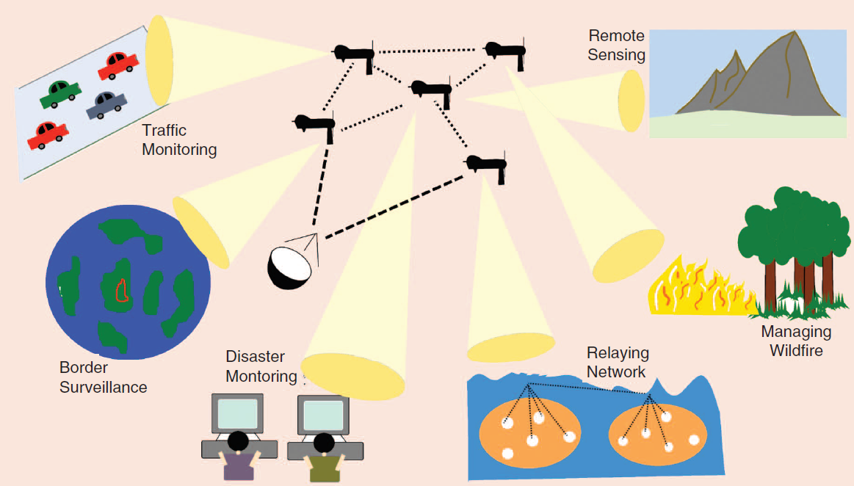
Social and Technical Implications
Highly reliable communication
High Accuracy
Low Latency
Notes:
Technology impacts for our community
+areas without built out infrastructure
+places which are unmanageable for people unable to reach (wild fire)
+emergency situations like earth creak (ad-hoc networks allowed communication between devices in April 2015 after the Nepal earthquake)
+traffic monitoring predict arrival
All examples immediate processing and transmitting of data
-monitoring applications, for example watching the border crossings
-FANETs are a probable victim of attacks (sensitive information handling)
· 1 The use of Surveillance tasks requires a high act of accuracy with sensitivity of the data.
22 Low Latency Requirement Quality of Service (QoS (decreasing the hop counts with long transmission ranges)
3 communication must be highly reliable (swarm formed &routing protocols)

Slide 6
Communication Architectures
UAV Ad-Hoc Network
Multigroup UAV Ad-Hoc Network
Multi-Layer UAV Ad-Hoc Network
Notes:
UAVs and base station must exchange information through a predefined infrastructure called communication architecture
important role for real time communication between multiple components for a robust and reliable connection.

Slide 7
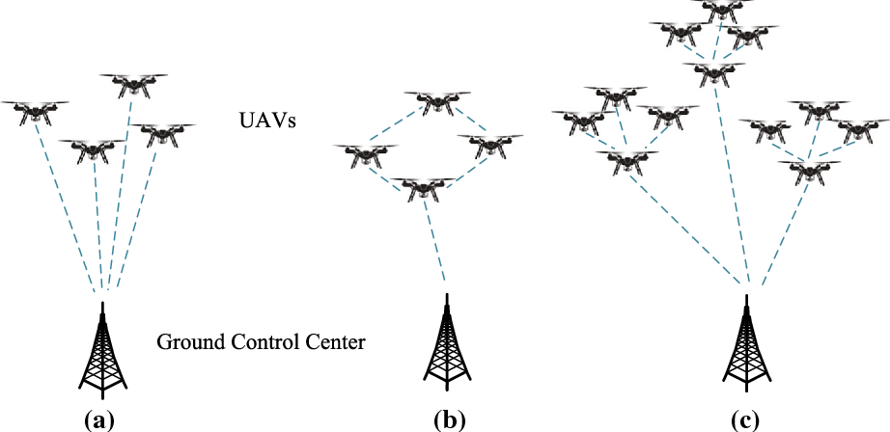
Communication Architectures
UAV Ad Hoc Network
Source:https://www.researchgate.net/publication/330825442_A_Hybrid_Communication_Scheme_for_Efficient_and_Low-Cost_Deployment_of_Future_Flying_Ad-Hoc_Network_FANET
Notes:
UAV Ad-Hoc Network
· no pre-established communication between UAV’s and base station
· backbone UAV acts as a gateway for communication
· Small distance between uavs
· speed and directions among the UAV’s should be similar for good connection
· suitable for smaller wireless networks

Slide 8
Communication Architectures
Multi-Group Ad Hoc Network
Source:https://www.researchgate.net/publication/330825442_A_Hybrid_Communication_Scheme_for_Efficient_and_Low-Cost_Deployment_of_Future_Flying_Ad-Hoc_Network_FANET
Notes:
Multigroup UAV Ad-Hoc Network
· UAV’s group in (ad hoc manner) - backbone UAV’s - ground station (centralized manner)
· suitable for large networks with multiple communication characteristics
· Intragroup communication is done without involving the ground station

Slide 9
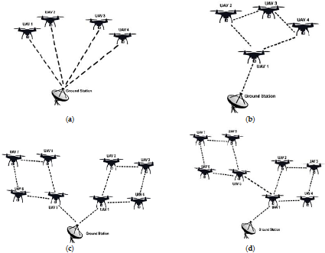
Communication Architectures
Multi-Layer UAV Ad-Hoc Network
Source:https://www.researchgate.net/publication/330825442_A_Hybrid_Communication_Scheme_for_Efficient_and_Low-Cost_Deployment_of_Future_Flying_Ad-Hoc_Network_FANET
Notes:
Multi-Layer UAV Ad-Hoc Network
· Heterogeneous UAVs forming a network
· lower layer: communication between the UAVs
· upper layer: communication between the backbone UAVs of all the connected groups and the ground station
· highly robust as there is no single point of error

Slide 10
Routing Protocols
The purpose of routing protocol is to learn about available routes that exist on the network, build routing tables and make routing decisions.
Notes:
Specifies how multiple routes should communicate with each other, performing route discovery & distributing info in a network

Slide 11
Routing Protocols
Static Routing Protocols
Load Carry and Deliver Routing (LCAD)
Multilevel Hierarchical Routing (MLH)
Data Centric Routing (DCR)
Proactive Routing Protocols
Destination- Sequenced Distance Vector (DSDV)
Optimized Link State Routing (OLSR)
Reactive Routing Protocols
Dynamic Source Routing (DSR)
Ad Hoc On-Demand Distance Vector (AODV)
Time-Slotted On-Demand Routing
Notes:
Static routing protocol is used in cases where the topology does not change frequently. Due to this the routing tables are not updated while ongoing mission. Ground station is
responsible for storing entire mission’s information. Updating of routing table is a limitation in this protocol and hence if any failure occurs, it must wait for the completion of mission.
Proactive Routing Protocol is opposite to Static Routing Protocol. It updates the topology of the entire network periodically. This type of nature also has a disadvantage a it stores overhead of information and might decrease overall throughput. It is not suitable for dynamic and large networks. It has a very slow reaction to connection or information failure.
RRP is widely known as on-demand routing protocol. Unlike in other protocols, the routes are not calculated if there is no information to be sent. Two types of messages are generated while calculating routes: (i) RouteRequest and (ii) RouteReply message. RouteRequest message using flooding mechanism to establish a path between source and destination. RouteReply message is sent by destination using unicast communication mode. One of the limitations of using Reactive Routing Protocol is high latency due to finding optimal route.

Slide 12
Routing Protocols
Hybrid Routing Protocols
Zone Routing Protocol (ZRP)
Temporarily Ordered Routing Algorithm (TORA)
Geographic/Position Based Routing Protocols
Greedy Perimeter Stateless Routing (GPSR)
Geographic Position Mobility Oriented Routing
Hierarchical Routing Protocols
Mobility Prediction Clustering Algorithm (MPCA)
Clustering Algorithm of UAV Networking
Notes:
Hybrid- Combination of Proactive Routing Protocol and Reactive Routing Protocol is called Hybrid Routing Protocol. The shortcomings and advantages of both are being used in this
protocol. It is suitable for wide area networks. Proactive Routing executes intra-zone routing whereas Reactive Routing introduces inter-zone routing.
Geographical information of the network is used in this network for increasing mobility efficiency. UAVs are aware about their geographical location without performing route discovery by using gps.
Hierarchical- proactive routing and reactive routing are performed in hierarchical or architecture level. Using the proactive nature, routing tables and routes
are pre-planned and information is sent to the nodes using reactive routing. As there exists a tier level system, the complexity of the network while data traffic increase with
time.

Slide 13
Implementation
Experimental Analysis of multiple routing protocols in Flying Ad Hoc Networks (FANET) - Proactive & Reactive Routing Protocols

Slide 14
Results
Performance Evaluators:
Packet Delivery Rate
End - End Delay
Average Throughput
Notes:
Packet Delivery Ratio: It is defined as the percentage of packets delivered successfully to the destination node by source node. Higher the PDR, the better the protocol performs.
End-to-End Delay: It is regarded as the time taken by the packets to reach from source to destination. It includes the time taken by protocols for node discovery and delivery the complete data packets.
Throughput: It is defined as the successful packets delivered at the destination node at particular period of time. The better the Throughput, the better is the routing protocol’s performance.

Slide 15
OLSR vs DSDV
Optimized link State Routing Protocol (OLSR)
All nodes have a routing table containing routing information which is used by the entire node to choose a route from source to destination.
Best suitable in the highly dense network due to MPR
Usage of bandwidth gets increased.
Distance-Sequenced Distance Vector Routing (DSDV)
A table driven routing scheme for MANET which is based on the Bellman-Ford algorithm to calculate shortest-path developed by C.
It gives the loop free paths
Difficulty to maintain the route table for the large network because every entry is updated in the route table.
Notes:
OLSR -This protocol has low overhead in the network because of the use of multiple relays (MPR).
DSDV - The sequence number is given in the each table entry provided all destinations within network

Slide 16
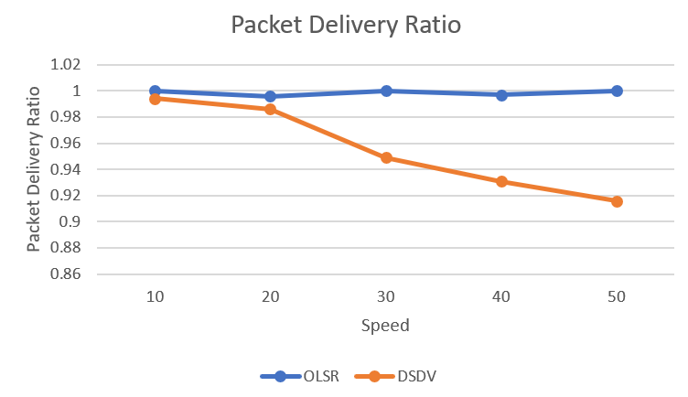
Notes:
Packet delivery of OLSR is consistent and is almost 100% with increase in speed.

Slide 17
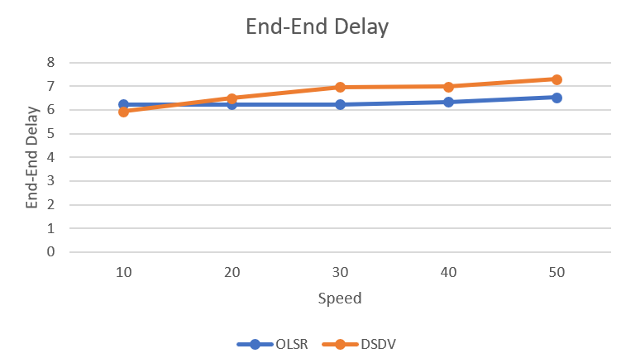
Notes:
Though OLSR started with high end delay with increase in speed it is lower than dsdv.

Slide 18
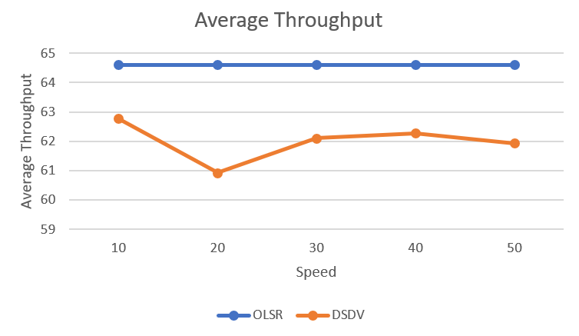
Notes:
Clear from graph that throughput is consistent for OLSR whereas for DSDV it fluctuates with high speed nodes.
OLSR performs better than DSDV, according to our results.

Slide 19
AODV vs DSR
Ad hoc On Demand Distance Vector (AODV)
One of the most widely used routing protocol in MANET. It is an on demand algorithm which is capable of both unicast and multicast routing.
Less overhead in the network.
To detect the next hop node, require on broadcast medium so that each node can detect each other's broadcasts.
Dynamic Source Routing (DSR)
An efficient routing protocol used for the wireless networks where multiple hops can takes place.
A single route discovery may yield many routes to the destination, due to intermediate nodes replying from local caches
Packet header size grows with route length due to source routing.
Notes:
AODV -It finds the route for the destination when route is desired by source node and maintained the route is kept until it is not required. AODV works in two steps: one is the route discovery and other one is route maintenance.
DSR -same as AODV that it forms a route using two mechanisms: Route Discovery and Route Maintenance

Slide 20
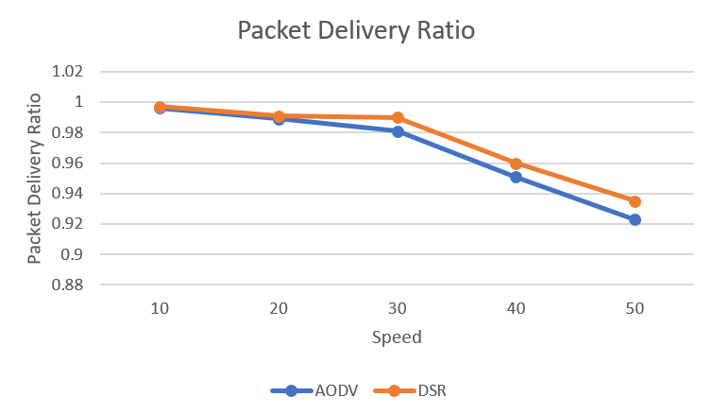
Notes:
Both protocols start with high packet delivery ratio close to 100% but with increase in speed they reduce . DSR still seems to perform better than AODV

Slide 21
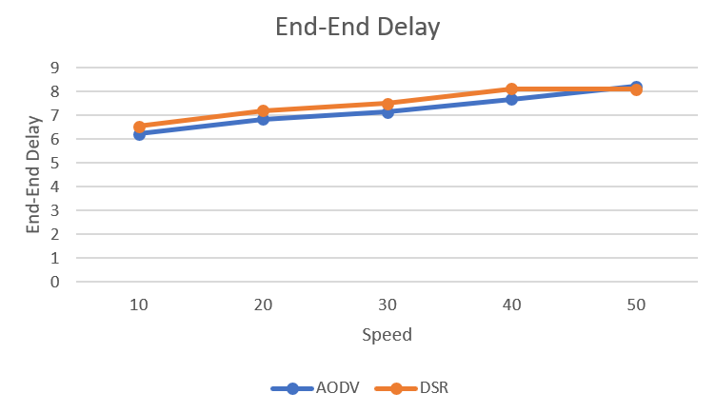
Notes:
In this evaluator, both protocols AODV & DSR are neck to neck and don’t show much variation.

Slide 22
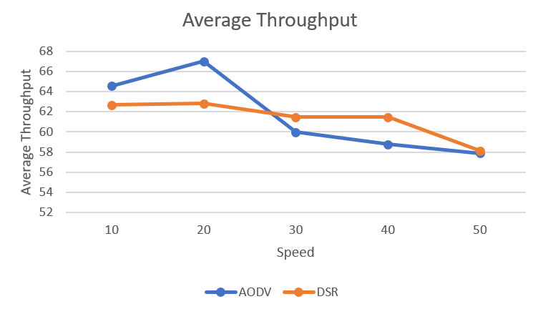
Notes:
AODV seems to be having high throughput for low speed nodes but depletes quickly after 30m/sec. Whereas DSR seems to be more consistent throughout.
DSR performs better than AODV, according to our results.

Slide 23
Conclusion
FANET - Social & Technical Implications
Communication Architectures & Routing Protocols
Experimental analysis on Routing Protocols
Notes:
Deduced that OLSR is better than DSDV & DSR is better than AODV

Slide 24
Thank you.

